Slide 1
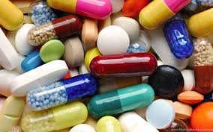
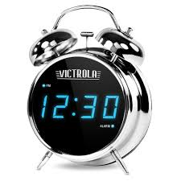
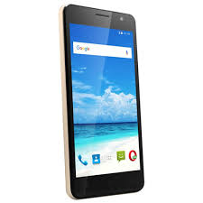
TABLET REM(A)INDER APP BASED ON THE TABLET CONSUMPTION (CSE-015)
BY
G.SOMESHWAR
K.MALVIKA
R.HEERA SHEETHAL
T.MADHURUSHA
PANIMALAR ENGINEERING COLLEGE
GUIDE
MRS K.LALITHA, ASSISTANT PROFESSOR(GRADE-I), DEPARTMENT OF IT, PANIMALAR ENGINEERING COLLEGE

Slide 2

PROJECT OVERVIEW
OBJECTIVE
MOTIVATION
MATERIALS REQUIRED
WORKING
DISPENSER SETUP
DISPENSER WORKING
ADVANTAGES
CONCLUSION

Slide 3
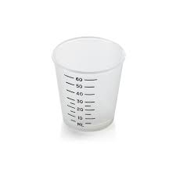
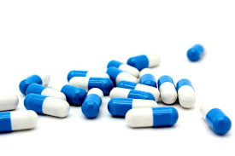
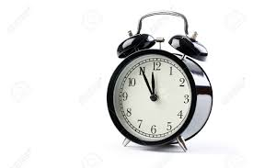
OBJECTIVE
Proper medicines
Proper proportion
Proper time

Slide 4
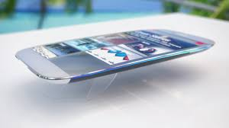


MOTIVATION
Inventions and advancement in technology

Slide 5
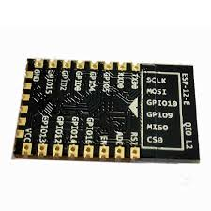
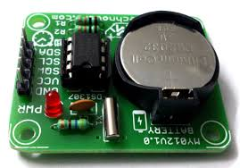
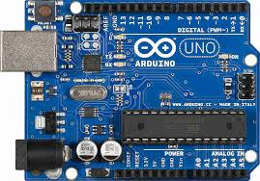
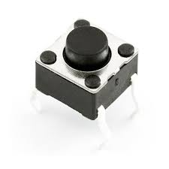
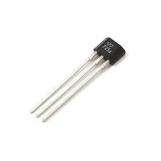
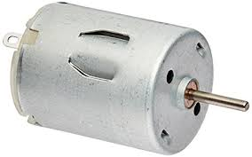
MATERIALS REQUIRED
Arduino board
ESP-12E
DS1307 RTC
Tactile switches
Hall-effect sensor
DC Motor

Slide 6
WORKING

Slide 7
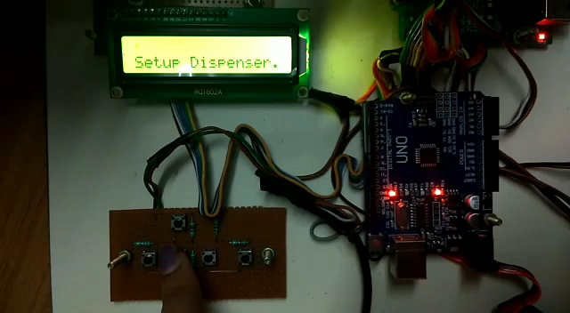
DISPENSER SETUP

Slide 8
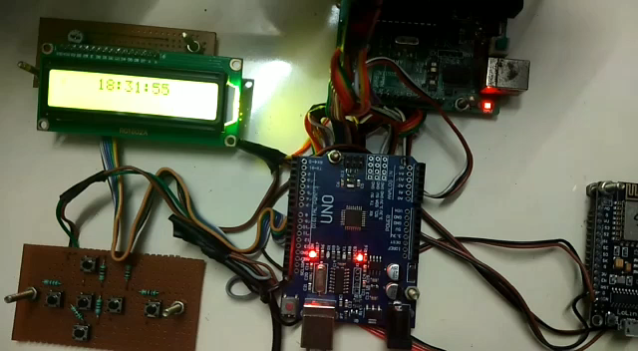
DISPENSER WORKING

Slide 9
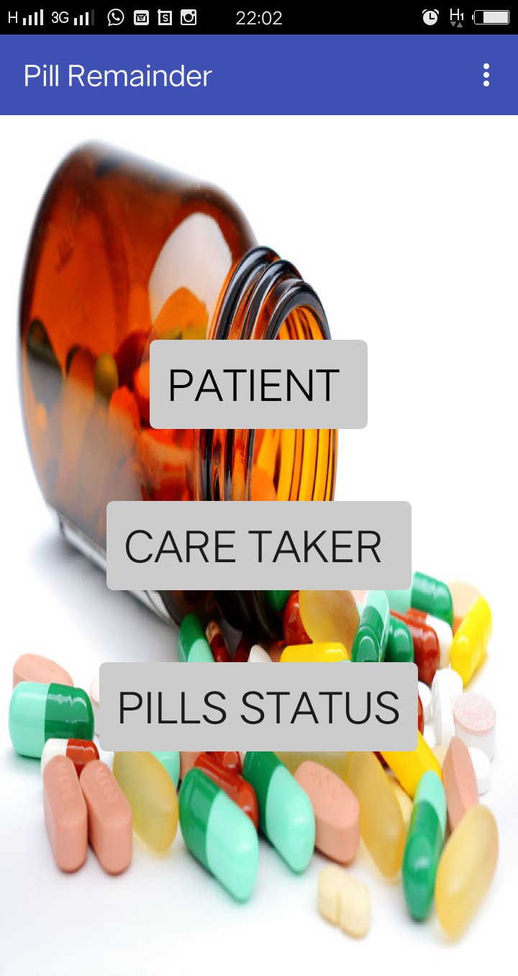
PILL
REMAINDER

Slide 10
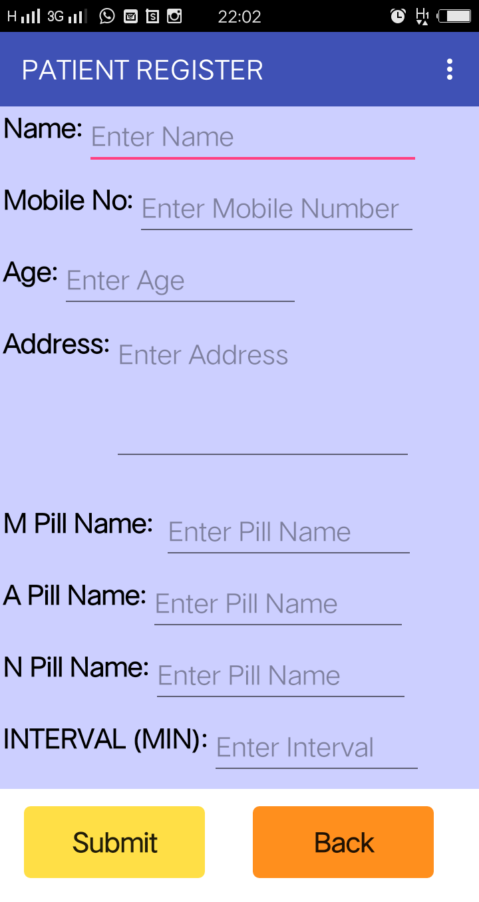
PATIENT REGISTER

Slide 11
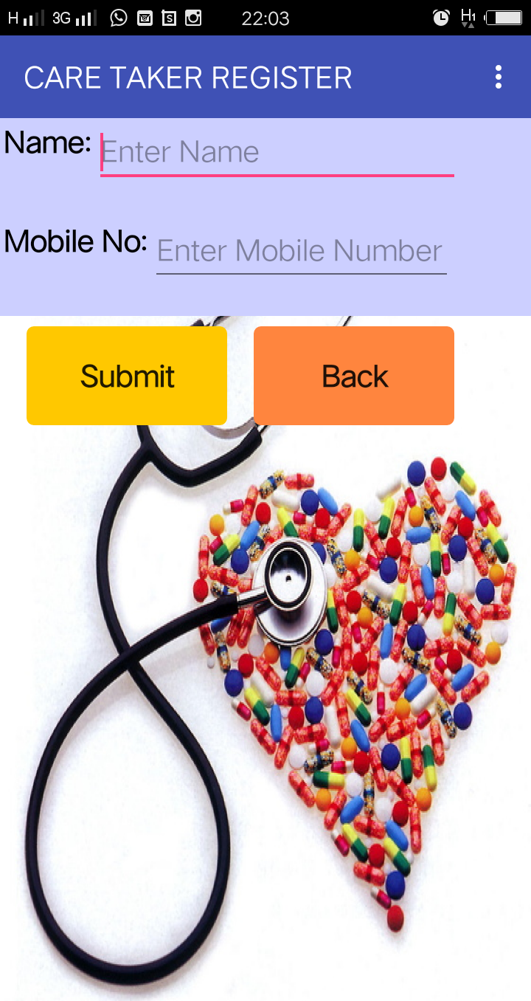
CARE TAKER REGISTER

Slide 12
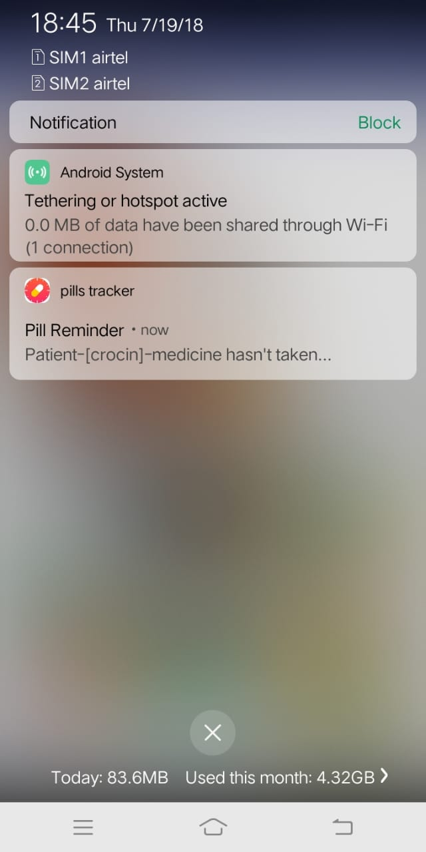
PILL REMAINDER NOTIFICATION FOR PATIENT

Slide 13
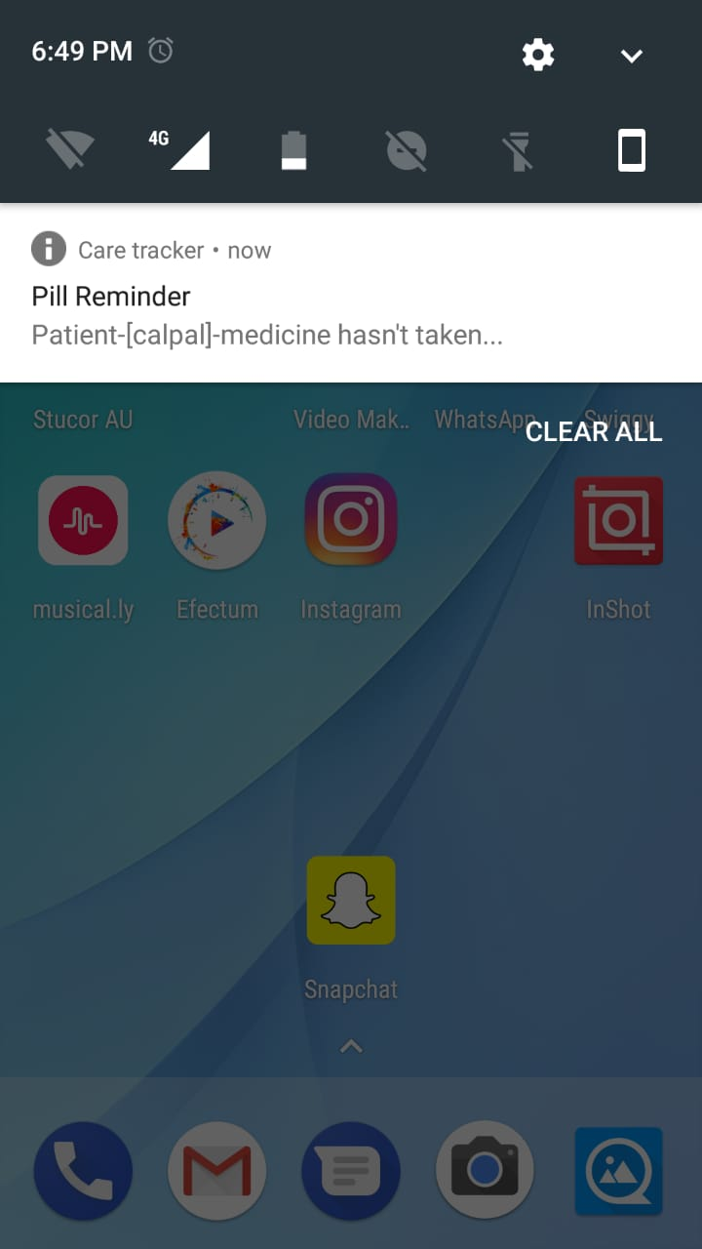
CARE TAKER NOTIFICATION

Slide 14
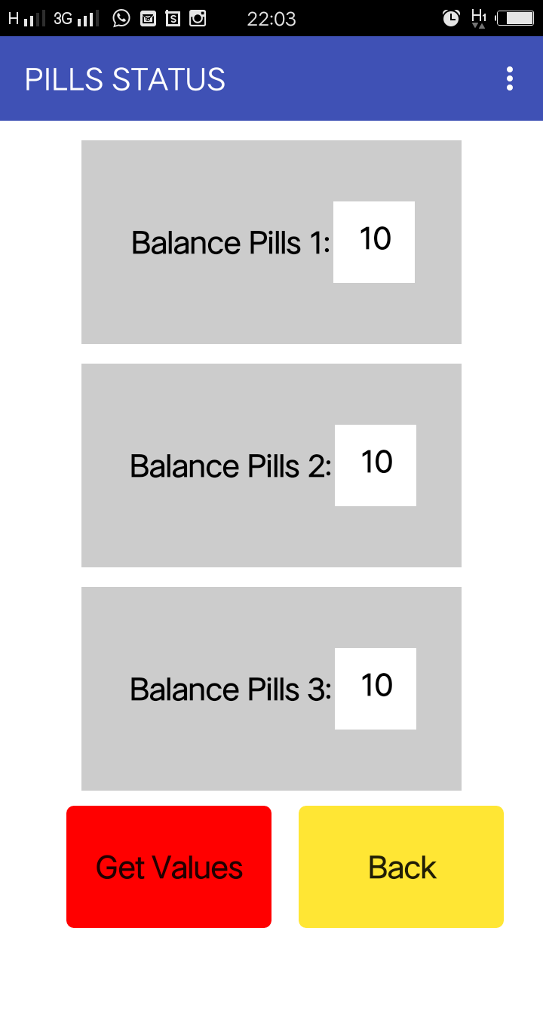
PILL
STATUS

Slide 15
ADVANTAGES
Helps senior citizens
User friendly
Schedule dosages is provided
Tracks adherence
Provides multi device support

Slide 16

CONCLUSION
Avoiding the risk that happens due to inappropriate intake of tablets on time
Cost-effective health care
Improvement of patient’s quality of life

Slide 17
THANK YOU

